Slide 1
THE PROGRESSIVE ERA: “CULTURAL IMPERIALISM”
The Transformation of the American Republic and Society

Slide 2
TABLE OF CONTENTS
The Rise of the Progressives
Who are they and what was their philosophy?
The Social Issues the Progressives Addressed
What were they concerned about in society?
The Governmental Issues the Progressives Addressed
What were they concerned about in government, and how did they seek to change government?
The Key Players in the Progressive Era
Who influenced ideas on society and government?

Slide 3
TABLE OF CONTENTS
The Progressive Publications
How did Progressive ideals get communicated?
The Progressive Constitutional Amendments
What were the common threads between them?

Slide 4
The Rise of the Progressives
Just as the 1st Great Awakening led to Revolutionary ideas in the mid-1700s…
The 2nd Great Awakening led to the “Pietistic” tradition in American Protestantism in the mid- 1800s
Prepare society and your neighbors for salvation
America was to be a ‘Christianizing’ force in the world
Government is viewed as a tool to accomplish this goal
The Pietists disdained the ‘Liturgical’ Christians such as Catholics and Lutherans who viewed the Church and State as separate and thought that religion was to be a personal, not national issue

Slide 5
The Rise of the Progressives
Early Reformers wanted to take on several issues in order to purify society and create a sort of ‘kingdom of God’ in the U.S.
Alcoholism
Poverty and Income Gaps
Child Labor
Christianizing Immigrants
Corrupt Political Machines
The Evils of ‘Monopoly’
Public Health

Slide 6
ALCOHOLISM
Early Reformers included women who wanted to ban alcohol consumption and production, who were later called Prohibitionists
They viewed hard liquor or ‘Demon Rum’ as something that kept people from sobriety
Big business leaders were also in favor of ‘dry’ laws which they believed made workers more productive
The Women’s Christian Temperance (MI) Union was formed in 1874
The Anti-Saloon League also was formed in 1893

Slide 7
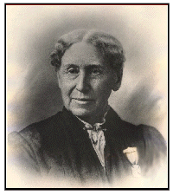
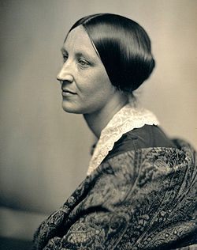
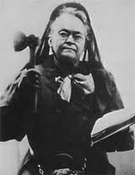
ALCOHOLISM
Some Famous Prohibitionists Included:
Annie Wittenmeyer, Susan B. Anthony and Carrie Nation

Slide 8
POVERTY AND INCOME GAPS
The Pietist tradition called for caring for the poor as a way to bring the poor to salvation
The Salvation Army is an organization set up to assist the poor for what goal??
Spiritual salvation:
The Young Mens Christian Association (YMCA) was set up for similar reasons in the 1860s

Slide 9
CHRISTIANIZING IMMIGRANTS
Jane Addams (Hull House) and the Settlement House movement had the goals of “Christian Humanitarianism”
The goals were to teach the poor and new immigrants
American English to endear families
American culture to remove their ‘old ways’
American ‘values’ of temperance and Christianity

Slide 10
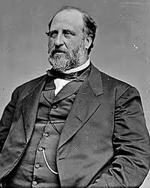
CORRUPT POLITICAL MACHINES
Corrupt, local political officials like Boss Tweed held tremendous power over their constituents
He ran the Democratic Political Machine in NYC called Tammany Hall
Jobs were exchanged for votes
Government contracts were exchanged for bribes
Progressives and Pietists wanted to concentrate political power in the Central government to stop the influence of these corrupt local officials, because they believed they were more ‘fit’ to govern than these local political bosses

Slide 11
RESISTING MONOPOLIES
The Progressive movement split over the existence of very large corporations
John D. Rockefeller (a pietist) said that competition was ‘evil’ so he tried to eliminate competition and wanted to use government influence to beat down his competition
Others wanted to regulate big business with laws like the Sherman Anti-Trust Act of 1890
This actually turned out to protect inefficient businesses that were failing to compete with large businesses
Sen. Sherman passed a new tariff law 3 months later to provide additional protections to those failing businesses

Slide 12
RESISTING MONOPOLIES
Later in 1914, the Clayton Anti-Trust Act was created to allow Unions and Farming Collectives to Act as Monopolies, but not Corporations
This Act was coupled with the creation of the Federal Trade Commission, which used government agents to investigate any possible violations of Anti-Trust Laws

Slide 13
PUBLIC HEALTH
Progressives focused their efforts on the health and safety of workers
Muller vs. Oregon limited the working hours of women to help them remain ‘healthy mothers’
Also, building and zoning codes were applied to cities for the purpose of planning society
The Triangle Shirtwaist Fire caused widespread anger when workers were chained inside and nearly 150 workers lost their lives

Slide 14
PROGRESSIVE ERA OR “DOMESTIC IMPERIALISM”
How the Republic is Transformed into a Modern State

Slide 15
REPUBLIC TO MODERN STATE
The Pietists and Progressives realized that there were 2 major obstacles to fulfilling their agenda:
The Constitution’s Checks and Balances
A Lack of Revenue
To get around the problems of Checks and Balances they sought to transform the Presidency
Teddy Roosevelt felt that he had unique power because people from all around the country voted for him

Slide 16
REPUBLIC TO MODERN STATE
Wilson said of the Presidency:
“No government can be successfully conducted with so mechanical a theory…leadership and control MUST BE LODGED (in the President himself)”
In other words, the Constitution doesn’t work, we must have authority resting in the President alone
Wilson relied on the teachings of a German Historicist named George Fredrich Hegel
The Government’s Lack of Revenue is fixed with 2 new Institutions in 1913:
Federal Reserve System
16th Amendment-Income Tax

Slide 17
REVENUE TO THE STATE
The Federal Government was enabled to spend more money than ever by taxing its citizens’ income
The original debate in Congress indicated that the new revenue would be temporary and be used to pay for war
Senator Aldrich (Father-in-law of John D. Rockefeller Jr.) knew that an income tax would allow the US government to pay for the interest on their debts to the Federal Reserve System

Slide 18
REVENUE TO THE STATE
The Federal Reserve System was developed 3 years before it was signed into law by Nelson Aldrich and men from Rockefeller’s and Morgan’s organizations
The new sources of revenue allowed the Progressives the cash they needed to install their programs and agencies to force the rest of society to live up to their expectations

Slide 19
THE PROGRESSIVE ERA AGENCIES
One unique feature of these agencies is that they hold all three powers of government within themselves
Make Laws
Enforce Laws
Interpret the use of Laws
Federal Trade Commission
Used to track down and sue businesses that out-competed their smaller competitors
Force compliance with Sherman and Clayton Acts

Slide 20
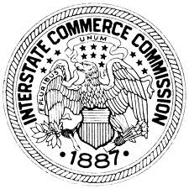
THE PROGRESSIVE ERA AGENCIES
Food and Drug Administration
Enforce the rules of the Pure Food and Drug Act
Children’s Bureau
Develop and Enforce laws regarding Child Labor
Interstate Commerce Commision
Regulate the railroad industry
Bureau of Mines
Regulate, monitor and block the activities of mining operations

Slide 21
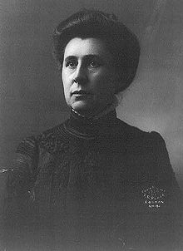
PROGRESSIVE ERA “MUCKRAKERS”
Ida Tarbell
Her father and brother worked for the Pure Oil Company and were out-competed by Standard Oil and had to sell
She devoted her life to bringing down Standard Oil the way Thomas Nast had brought down Boss Tweed
Many credit her with helping bring about the US vs Standard Oil Case
McClure’s magazine published her articles which often made emotional arguments and did not reflect a knowledge of economic realities
Even she admired the efficiency of Standard Oil, but resented its success

Slide 22
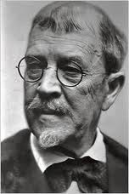
PROGRESSIVE ERA “MUCKRAKERS”
Lincoln steffens
Covered the Soviet Revolution and declared “I have seen the future and it works!”
He strongly believed that the U.S. should adopt Socialism, because he believed that it would benefit everyone
He also wrote for McClure’s magazine along with Tarbell and Baker

Slide 23
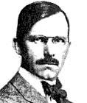
PROGRESSIVE ERA “MUCKRAKERS”
Ray stannard baker
Wrote for McClure’s Magazine along with Tarbell and Steffens
Wrote under the alias David Grayson
Covered the events of the Pullman Strike and Coxey’s Army with graphic detail
He
Wrote an 8-volume biography of Woodrow Wilson after supporting his campaign in 1912

Slide 24
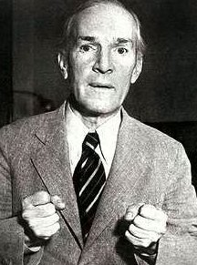
PROGRESSIVE ERA “MUCKRAKERS”
Upton sinclair
Wrote a novel called “The Jungle” which was a fictitious book loosely based on 2 weeks of time spent in a Chicago Meat-Packing plant
Although not factual, it left such an impression on the American public, that they hailed the passage of the Meat Inspection Act in 1906
Sinclair knew that the Meat Inspection Act was a betrayal, because the plants were already being inspected by government officials
The Act allowed large packers to continue their practices while helping create rules that kept smaller packers from entering the meat packing industry

Slide 25
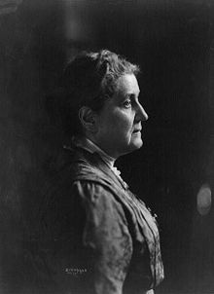
PROGRESSIVE ERA ACTIVISTS
JANE ADDAMS
Led the Hull House in Chicago Illinois
Helped the Settlement House movement that took immigrants into their buildings to:
Christianize
Educate for work
Civilize for US culture
Provide food and clothing
Addams wanted to be sure that her workers were pietists, as opposed to the liturgical variety of Christians
This position was reflective of the pietists who wanted to use faith to change society

Slide 26
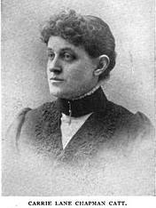
PROGRESSIVE ERA ACTIVISTS
CARRIE CHAMPAN CATT
Began her activist career as a Prohibitionist, much like other female pietists
She followed Susan B. Anthony as the President of the National American Woman Suffrage Association
NAWSA was created when 2 groups merged to gain the vote:
National Woman Suffrage Association
American Woman Suffrage Association
Eventually, suffrage was granted when Wilson realized that these women would be voting for his party if he pushed the 19th Amendment

Slide 27
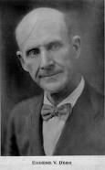
PROGRESSIVE ERA ACTIVISTS
Eugene debs
Eugene Debs was a Socialist and Railroad Union Leader that led the Pullman Strike in Chicago, not a Progressive
Socialists advocated the government take over of the “Means of Production”
Factories, Roads, Steel, Oil, Railroads
Debs criticized the U.S. role in World War 1 and encouraged men to dodge the draft
He was arrested under the Espionage Act of 1917 and Sedition Act of 1918
He ran for President in 1920 from prison

Slide 28
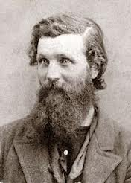
PROGRESSIVE ERA ACTIVISTS
John muir
Muir was an early preservationist who created the Sierra Club
He invited Teddy Roosevelt to join him for camping in Yosemite Valley and the Hetch Heche Valley
National Park Service was created in 1914 to create parks and to limit commercial development in those parks
Muir was a Preservationist, not a Conservationist and advocated that trees never be cut down

Slide 29
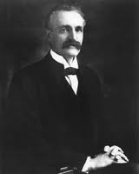
PROGRESSIVE ERA ACTIVISTS
Gifford pinchot
Pinchot helped create the US Forestry Service
It was created to manage the resources within the National Parks
Today, the Federal Government owns nearly half of the lands in the Western United States
The Preservationist approach has led to the overplanting of trees throughout the National Parks
This overplanting is seen in Yosemite Valley in these pictures:
Natural Valley Floor
US Forestry Valley Floor

Slide 30
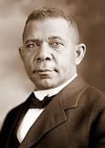
PROGRESSIVE ERA ACTIVISTS
Booker t. washington
White Progressives almost completely ignored African-Americans rights
Washington thought that Blacks should earn equality through education and hard work
He envisioned schools for southern Blacks and got matching grants from Sears Roebuck Co. of $25,000 to create them
With those funds he helped found the Tuskegee Institute
He also Gave the “Atlanta Compromise” Speech

Slide 31
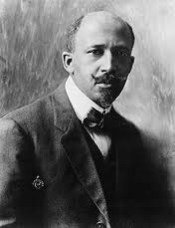
PROGRESSIVE ERA ACTIVISTS
W.E.B. Dubois
He favored a more aggressive pursuit of equal rights for African-Americans than did Booker T. Washington
He wanted to use the government to grant equal rights in voting and in all other areas, rather than using the marketplace of ideas
The National Association for the Advancement of Colored People (NAACP) was his creation
He wanted to use it to uncover and attack racist acts like lynching and institutions like Jim Crow Laws in the South

Slide 32
PROGRESSIVE ERA ACTIVISTS
Walter Rauschenbush
Key person in creating the ‘Social Gospel’
Equated Christian living with Collectivism, Socialism, Pacifism and Internationalism
Helped form an organization called the Brotherhood of the Kingdom
The ‘Brotherhood’ was dedicated to realizing the Kingdom of God on earth
He was a key inspiration to religious leaders such as Martin Luther King Jr. and Bishop Desmond Tutu of South Africa

Slide 33
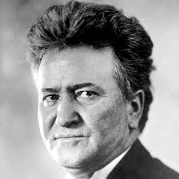
PROGRESSIVE ERA POLITICIANS
ROBERT LAFOLLETE
Governor of Wisconsin from 1911-1915 introduced concepts that reflected Hegel’s ideas of the state
The underlying purpose was to draw individuals into closer contact with the state and its attempts to control and plan society
The ‘Wisconsin Plan’ relied on professors at U of W to create legislation, using their ‘expert’ opinions
Recalls allow for the removal of officials, Referendums allowed citizens to vote on legislative proposals and Initiatives allowed voters to create bills for the legislature’s approval

Slide 34
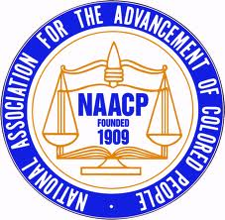
PROGRESSIVE ERA CITIZEN ORGANIZATIONS
NAACP
The National Association for the Advancement of Colored People was the brainchild of W.E.B. DuBois
After meeting in Canada at Niagara Falls (creating the ‘Niagara Movement’) in 1905, the NAACP was created in 1909
The main targets of concern were lynching, voting rights and segregation
Their movement gained momentum after the race riots of 1908 highlighted racial tension in American cities

Slide 35
PROGRESSIVE ERA CITIZEN ORGANIZATIONS
WctU
The Women’s Christian Temperance Union was founded in 1874
Pledges were made by members who promised never to use alcohol and to use any means necessary to prevent its use by others as well
The organization was also concerned about preventing prostitution, tobacco use and child labor
They were also a pacifist organization which opposed war
Eventually womans suffrage became a key issue for them as well

Slide 36
PROGRESSIVE ERA AMENDMENTS
16TH AMENDMENT
17th Amendment
Allows the federal government to collect income taxes to pay for war debt
The debt would be paid (with interest) to the newly created Federal Reserve Banking System
The Direct Election of Senators comes from a direct election within each state
This effectively ends the concept of federalism, where the state legislatures used to have a say in federal politics, because people now elect Senators in the same manner as they elect the President

Slide 37
PROGRESSIVE ERA AMENDMENTS
18TH AMENDMENT
19th Amendment
The manufacture, sale, transportation of …LIQUOR…or the exportation (of liquor) is banned
The Volstead Act is passed by Congress to give specific details about what to enforce and was mostly written by Wayne Wheeler of the Anti-Saloon League
It allowed production of alcohol of less than 0.5%
Voting rights could not be limited based on gender
Women’s right to vote came about after many years of struggle
The Pietists and Progressives now had a greater voice in government as the WCTU advocated:
Agitate-Educate-Legislate

Slide 38
PROGRESSIVE ERA PUBLICATIONS
Mc clures Magazine
The new republic
Founded in 1893, hired such muckraking journalists as:
Ida Tarbell
Lincoln Steffens
Ray Stannard Baker
Albert J. Nock
Open attacks on Standard Oil and US Steel
Key writers left in 1906 over disagreements
Founded by Walter Lipmann & Herbert Croly in 1914
They openly encouraged domestic and international imperialism by the U.S.
There was also an open support of the Soviet Program after some of its journalists covered the Russian Revolution

Slide 39
PROGRESSIVE ERA AND INTERNATIONAL IMPERIALISM
The Natural Consequence of Domestic and Cultural Imperialism

Slide 40
The Rise of International Progressivism (Imperialism)
Alfred T. Mahan wrote a famous book called, “The Influence of Sea Power on History”
Naval power was seen as the tool to open markets overseas and express American military power and inspire fear in other nations
Mahan’s writings powerfully influenced politicians like Teddy Roosevelt
This inspired the creation of the “Great White Fleet”

Slide 41
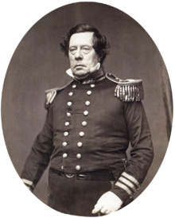
The Rise of International Progressivism (Imperialism)
Matthew C Perry was sent by Millard Fillmore to force a trade agreement with Japan in 1853
Perry’s navy with its steam-powered warships enter Tokyo Bay unannounced
The Japanese fearfully sign the Treaty of Kanagawa
This action was an early signal that US Imperialism would not stop at the Pacific Coast of California, but that Manifest Destiny would be a global mission

Slide 42
The Rise of International Progressivism (Imperialism)
John Fiske presses the belief that Anglo-Saxons are destined to civilize the rest of the world through:
Democracy
Language
Religion
Since they had conquered the American Continent, the Caribbean and Pacific were logically the next

Slide 43
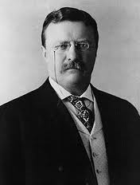
The Rise of International Progressivism (Imperialism)
Teddy Roosevelt eventually became the President after McKinley’s assassination
In order to move the American Empire to the Far West more quickly and efficiently, a Central American Canal was necessary
After Vanderbilt’s Nicaraguan Canal system was taken over and eventually destroyed, the stage was set for TR’s takeover of the Panama Canal Zone

Slide 44
The Rise of International Progressivism (Imperialism)
In 1903, TR became aware that the province of Panama wanted to break away from its national government of Colombia
Roosevelt cleverly sent US warships to the area in support of this Revolution
When the US showed its military might, the Colombians gave up Panama
In exchange for military support, the Panamanians had to give up the canal zone to the US

Slide 45
The Rise of International Progressivism (Imperialism)
Roosevelt then made certain that the loan which was taken out to pay for the canal’s construction went to a bank controlled by…
NONE OTHER THAN JP MORGAN AND HIS OWN BROTHER-IN-LAW, DOUGLAS E. ROBINSON
The US now would build its’ canal, enrich TR’s and Morgan’s families and allow for the quicker expansion of the US Empire.

Slide 46
Every Empire Needs its Heroes
Teddy Roosevelt’s personality carried him to great popularity
He was and still is viewed as a great President by many
TR viewed war as a way for a man and a country to establish greatness and strength
The Spanish-American War provided TR with the kind of opportunity to display his bravery and courage

Slide 47
The “Splendid Little War”
Up until the late 1800s the Spanish Empire still maintained colonies in:
The Philippines
Cuba
Guam
Puerto Rico
The US’s Imperial Vision could not tolerate Spain’s presence, especially in the Western Hemisphere
As a result, supporters of the Imperial Vision looked for ways for the US to first become the single dominant power in the Western Hemisphere

